Slide 1
Organizational Text Structure

Slide 3
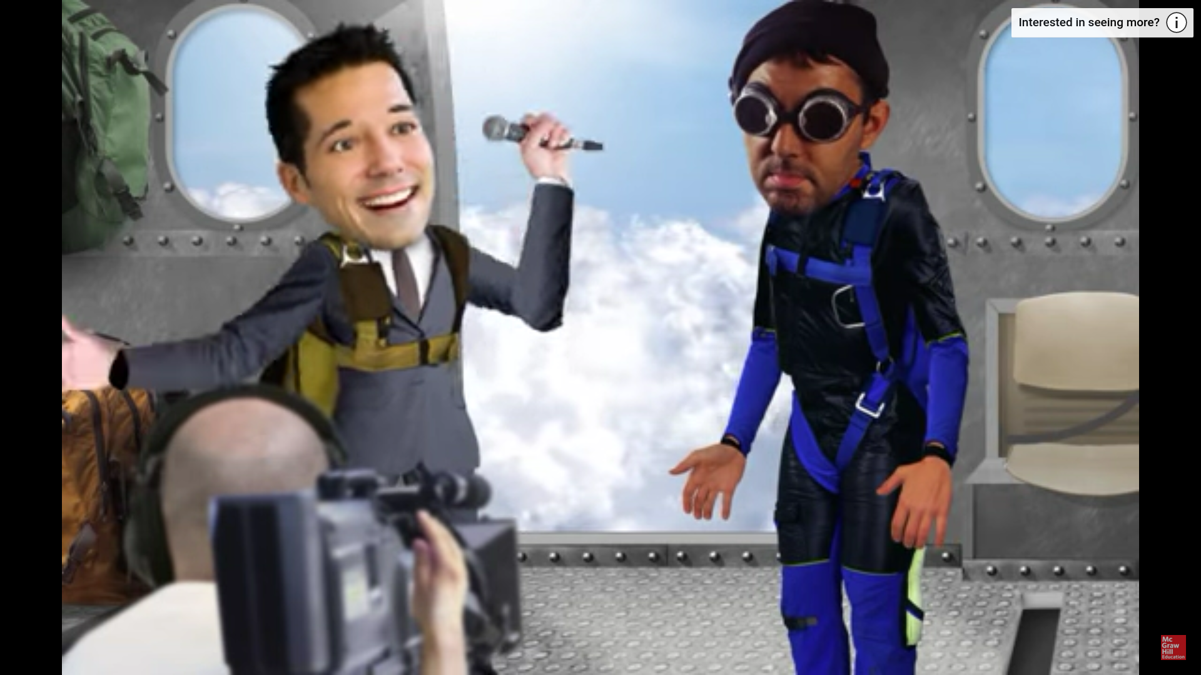
Name that Text Structure
https://www.youtube.com/watch?v=P-PnCBQ60PA&list=PLzjX3a1Vo78P5oC6kwOheIpfefdQkwlus

Slide 4
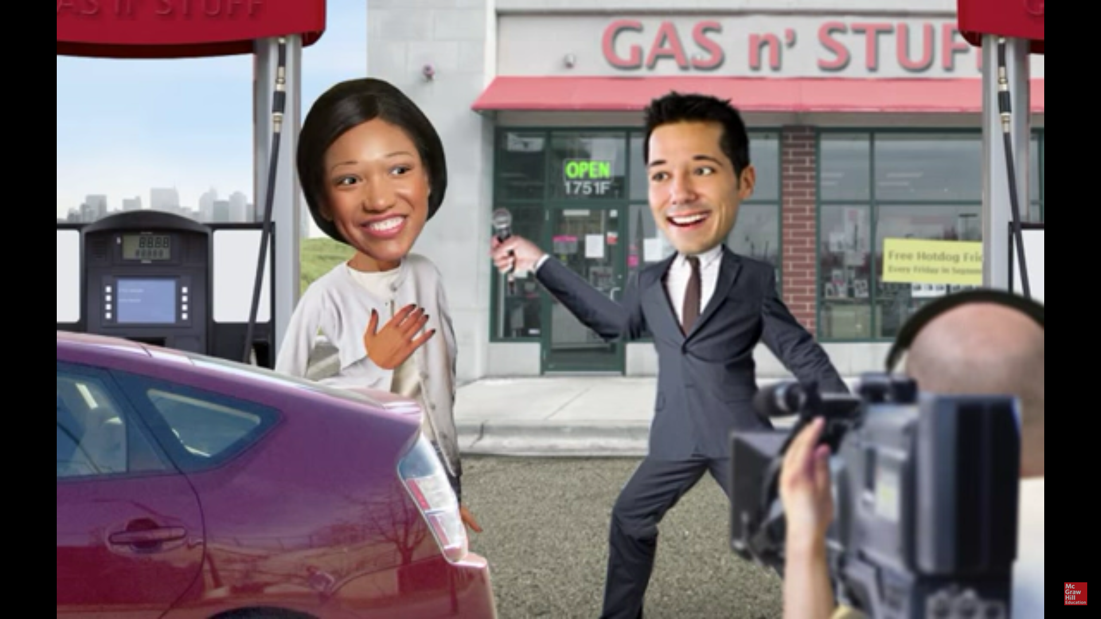
Name that Text Structure
https://www.youtube.com/watch?v=wPoxKFQlIgA&list=PLzjX3a1Vo78P5oC6kwOheIpfefdQkwlus&index=2

Slide 9
cause
effect

Slide 11
Ground water evaporates and turns into vapor.
The vapor condenses into tiny droplets and forms clouds.
The clouds lose the water in the form of precipitation.
Time Order
Chronological Order
Sequential Order

Slide 14
Compare and Contrast

Slide 15
Cause and Effect

Slide 16
Chronological Order

Slide 17
Cause and Effect

Slide 18
Problem and Solution

Slide 19
Problem and Solution

Slide 20
Chronological Order

Slide 21
Cause and Effect

Slide 22
Compare and Contrast

Slide 23
Chronological Order

Slide 24
Cause and Effect

Slide 25
Chronological Order

Slide 26
Compare and Contrast

Slide 27
Cause and Effect

Slide 28
Chronological Order

Slide 29
Compare and Contrast

Slide 30
Description
Compare and Contrast
Problem and Solution
Chronological Order
Cause and Effect

