Slide 1
Figurative Language
Notes:
‹#›

Slide 2
Literal vs. Figurative Language
Literal Language – You say exactly what you mean. You make no comparison, and you do not exaggerate or understate the situation.

Slide 3
Figurative Language – You DON’T say exactly what you mean. You DO compare, exaggerate, and understate the situation. You use similes, metaphors, hyperboles, and other figures of speech to make your writing more exciting.

Slide 4
Literal or Figurative???
Grant always turns in his homework.
The water was rising in the river because of the rain.
Her teeth are like stars because they come out at night.
When she sings her voice is like velvet.
Half of the class did not complete the assignment.
I’m so hungry I could eat a horse.
Mike was so angry that steam was coming out of his ears.
The zebras cried when the wise old elephant died.
9. I’ve told you a million times to clean up your room.

Slide 5
Literal or Figurative???
The snow was coming down by the bucket-fulls.
Mary is always dressed neatly.
Native Americans believed that the sun was a god.
These bags are so heavy my arms are falling off.
Mrs. Brown sometimes gives us too much homework.

Slide 6
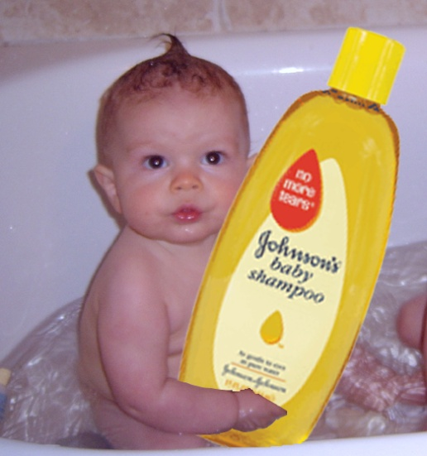
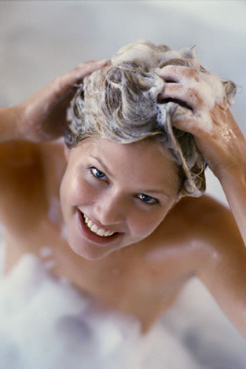
Seven Types of Figurative Language
Simile
Hyperbole
Alliteration
Metaphor
Personification
Onomatopoeia
Allusion
Idiom

Slide 7
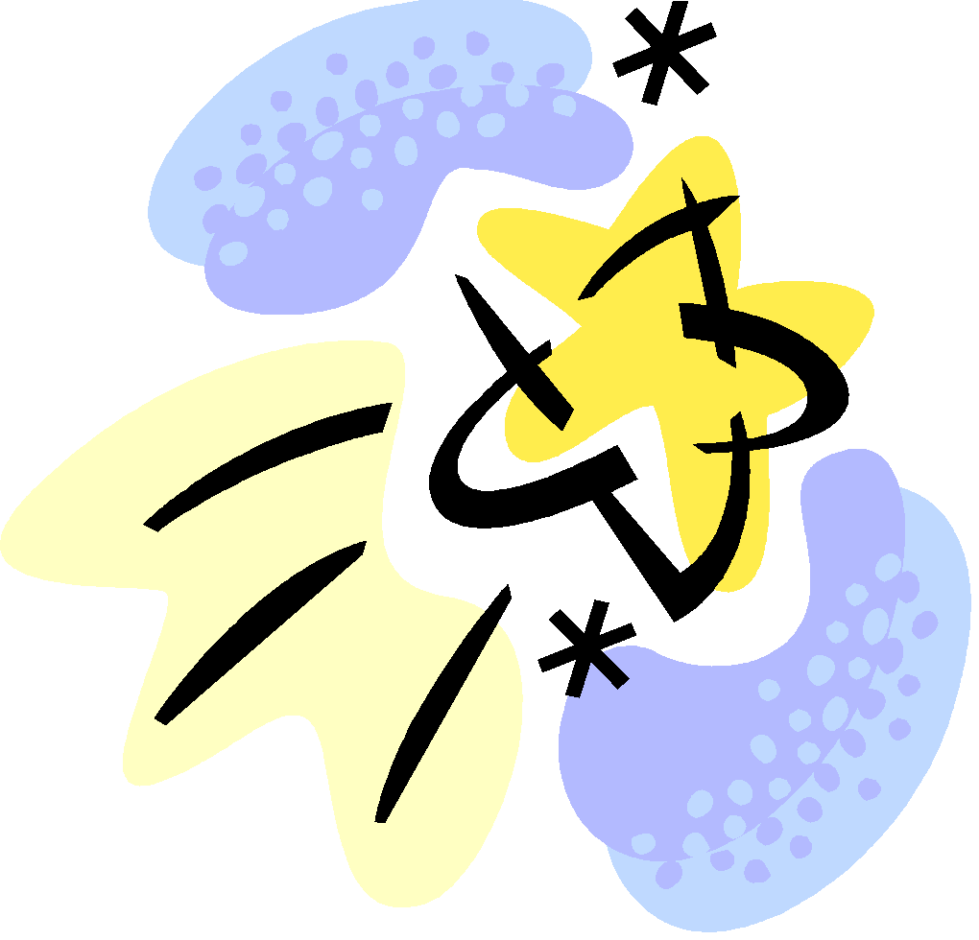
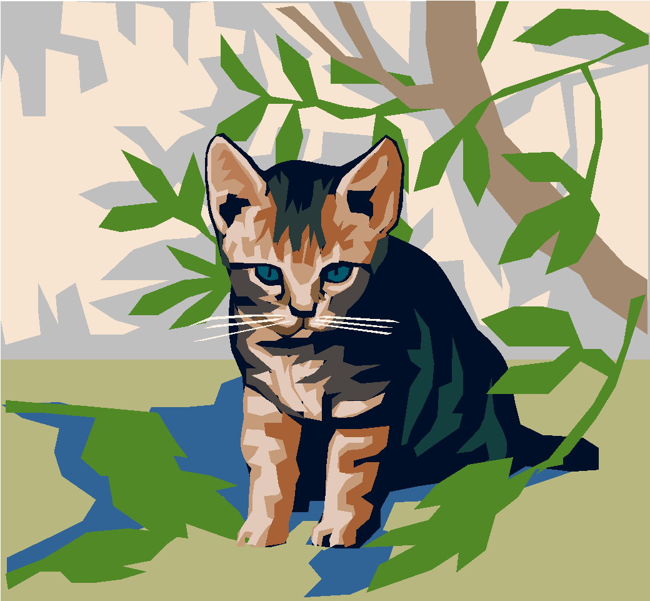
Simile
comparing two unlike things using the words “like” or “as”.
Her eyes were like stars.
Susan is as gentle as a kitten.

Slide 8
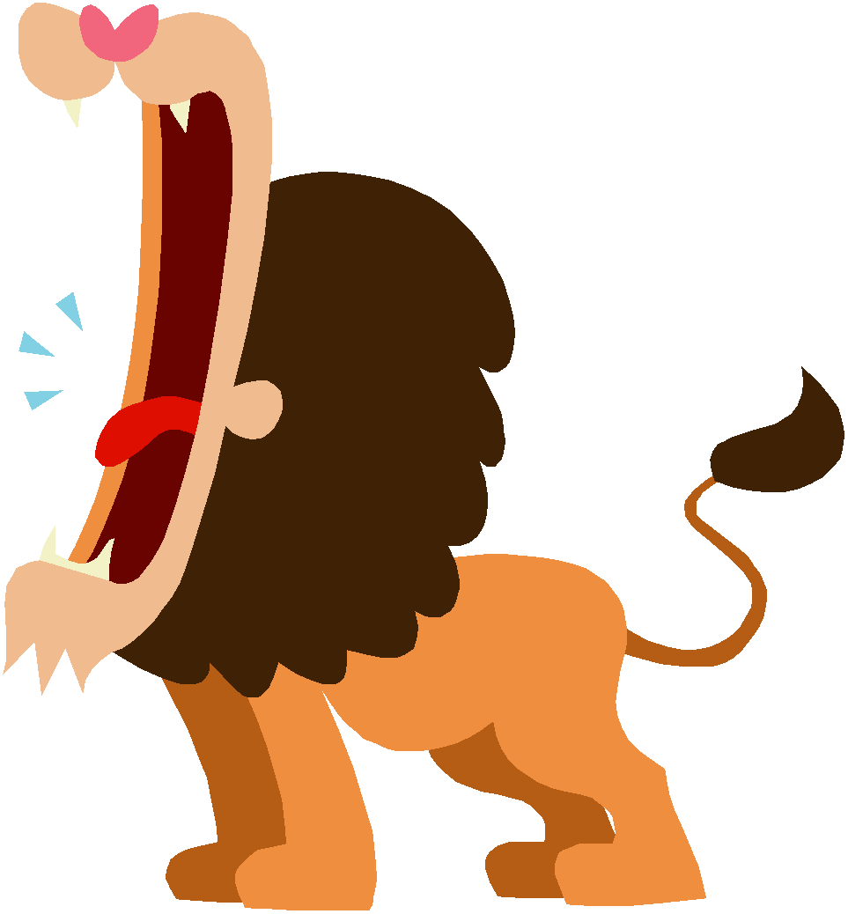
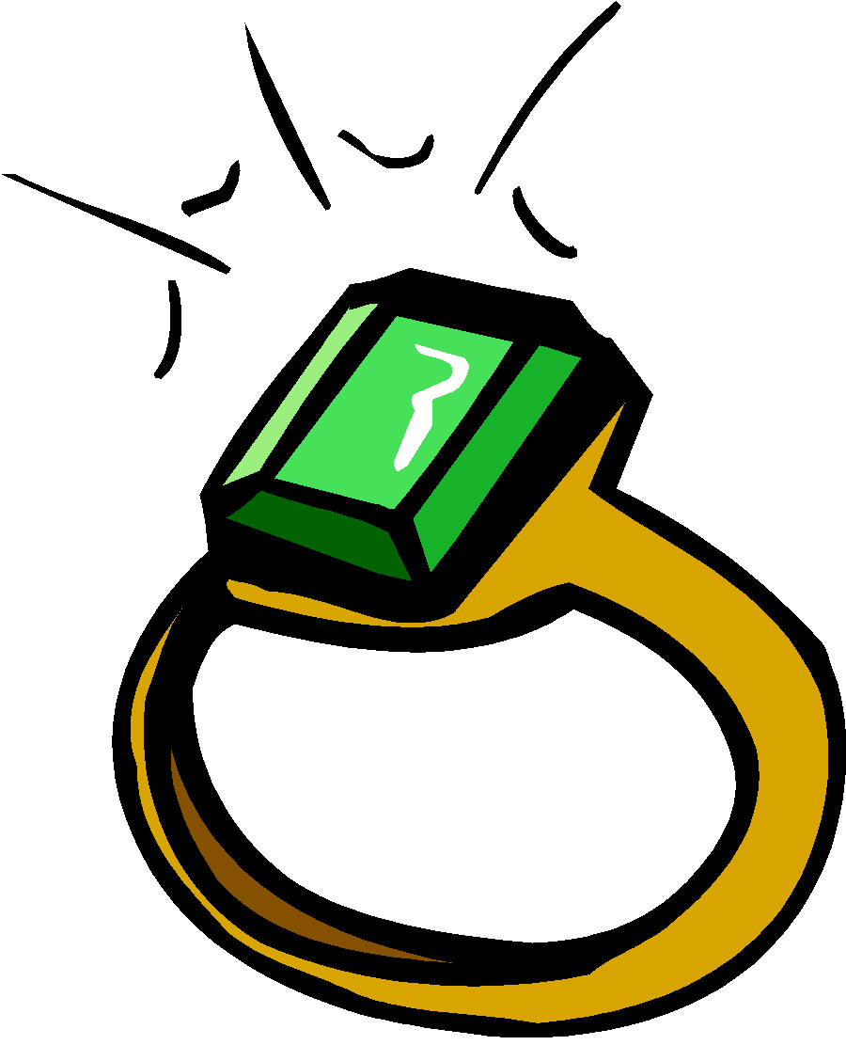
Metaphor
comparing two unlike things without using like or as. Calling one thing, another. Saying one thing is something else.
He’s a lion when he fights.
Her eyes were sparkling emeralds.
My love is a red, red rose.

Slide 9
Hyperbole
an exaggeration so dramatic, no one could believe it; overstate to emphasize a point.
This bag weighs a ton!
I’ve told you a million times to clean up your room!

Slide 10
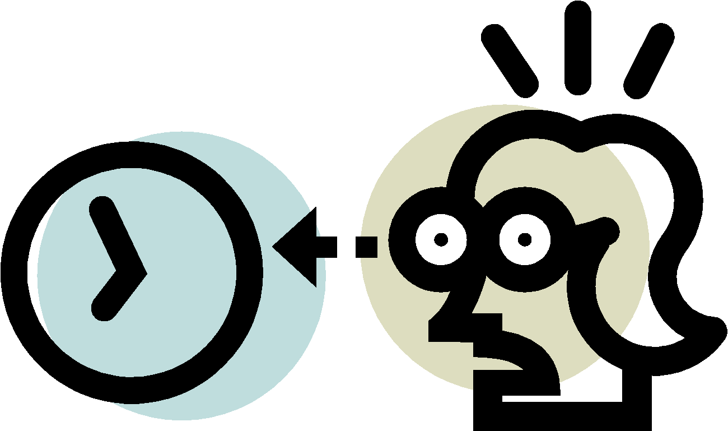
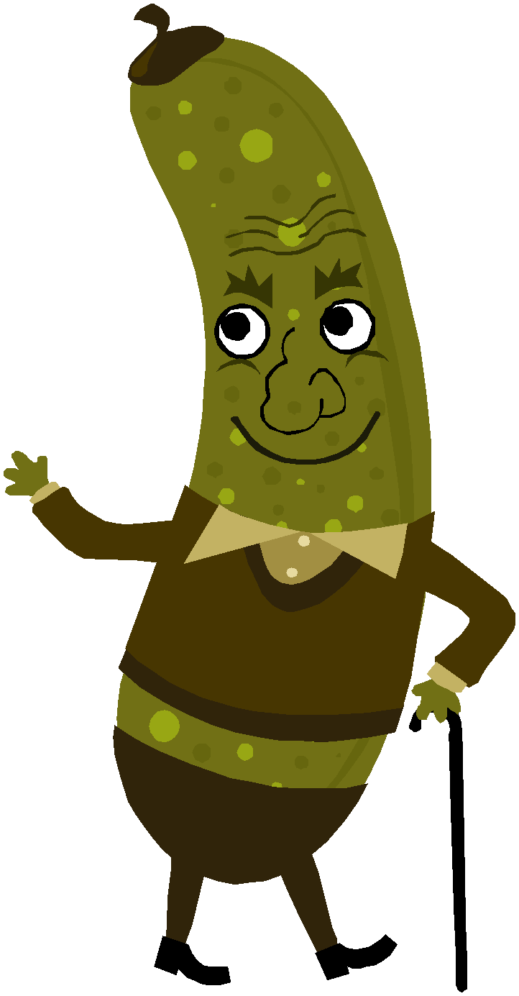
Alliteration
the repeating of the same letter or sound, especially consonant sounds….including tongue twisters.
Miss Warren was worried when Wendy was waiting.
Rubber baby buggy bumpers.
Peter Piper picked a peck of pickled peppers.

Slide 11
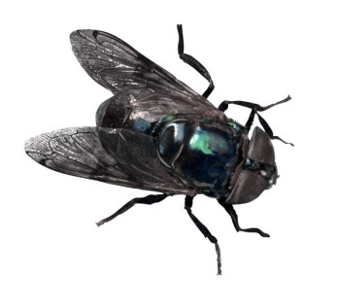
Alliteration in Poetry
A flea and a fly in a flue
Were imprisoned, so what could they do?
Said the fly, “Let us flee!”
“Let us fly,” said the flea;
So they flew through a flaw in the flue.

Slide 12
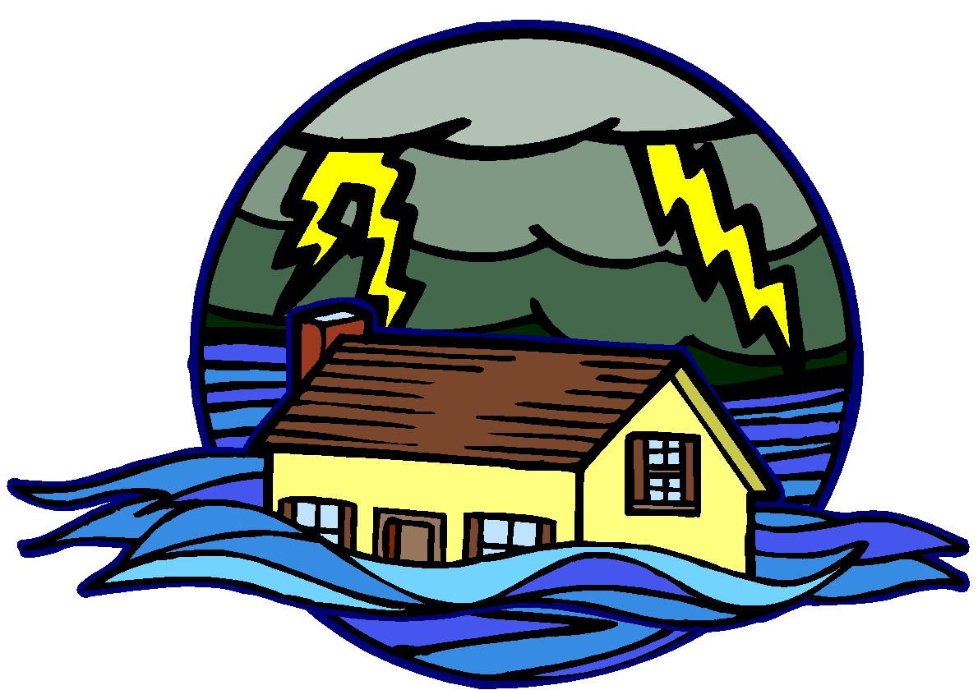
Personification
giving human characteristics to things that are not human.
The angry flood waters slapped the house.
The sun smiled down on us.

Slide 13
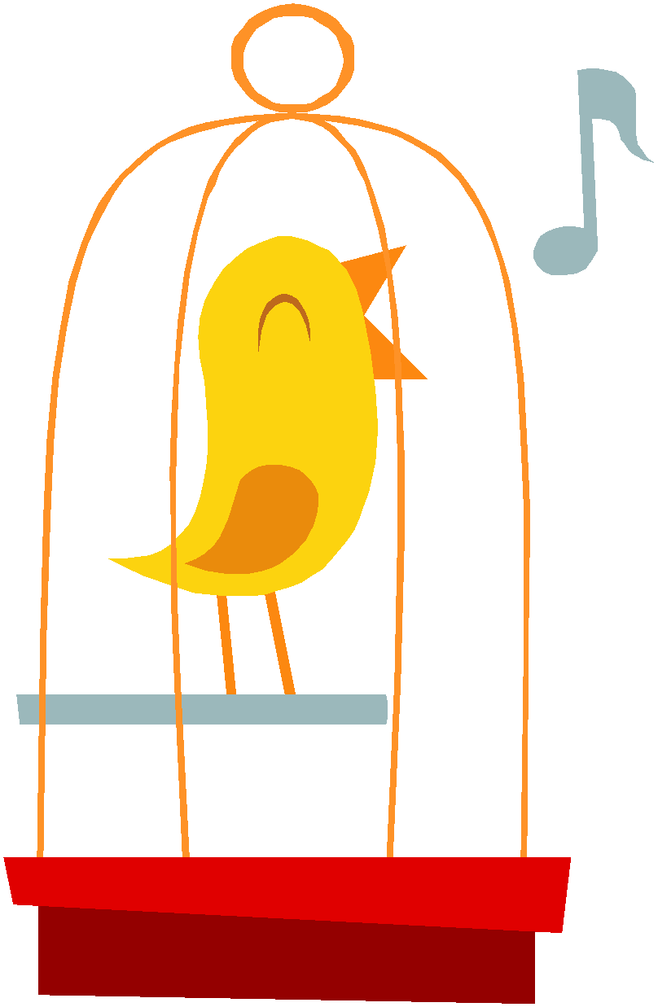
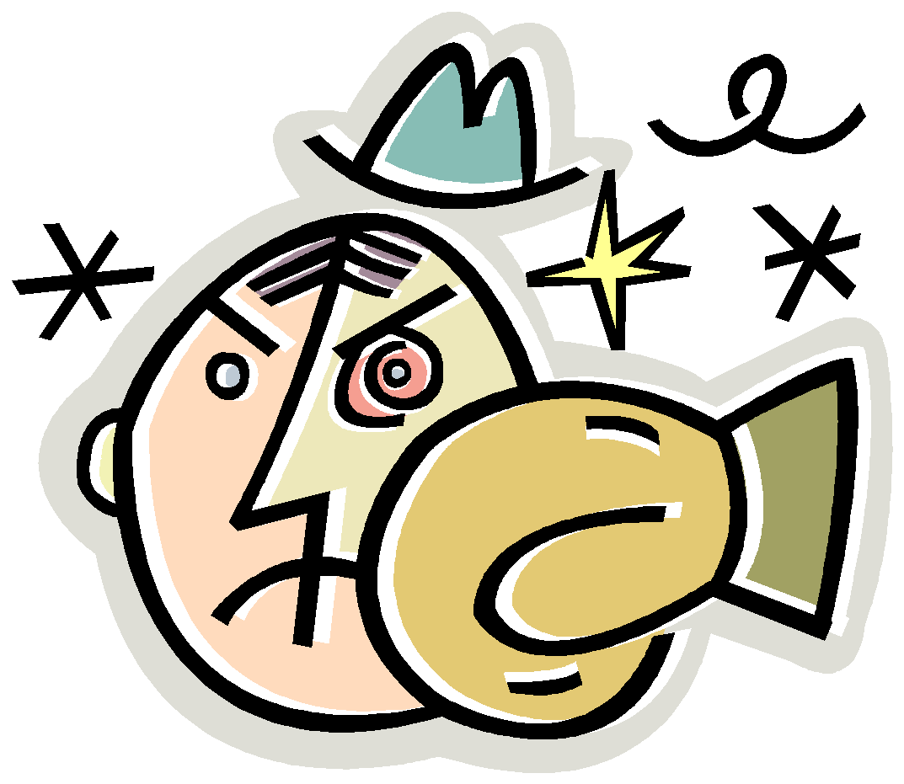
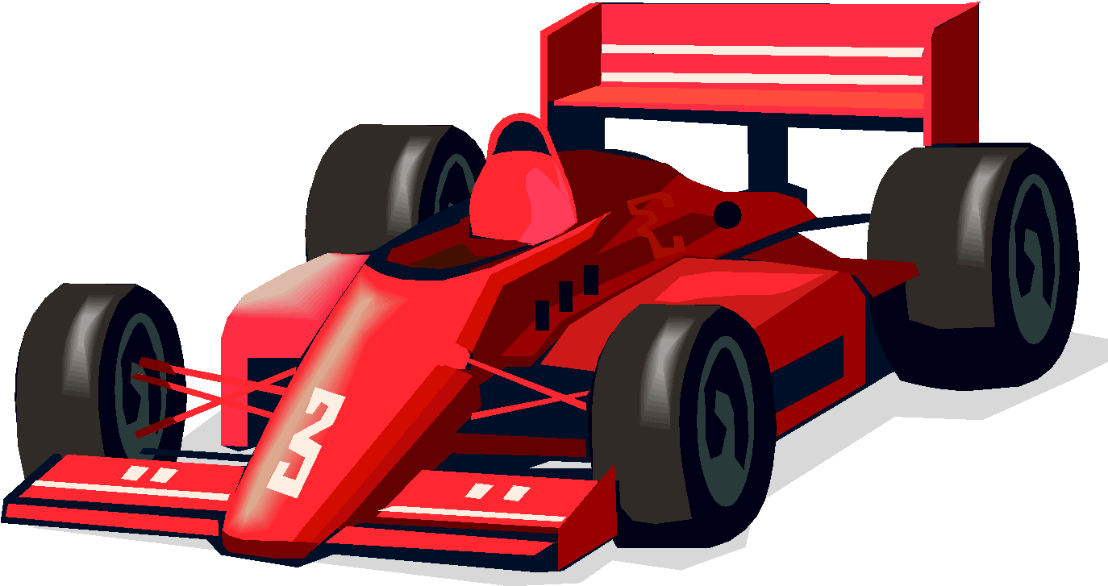
Onomatopoeia
the use of a word to describe or imitate a natural sound made by an object or action. Words that sound like what they mean.
tweet, tweet
pow
zoom
buzz
hiss

Slide 14
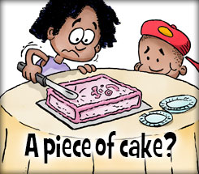
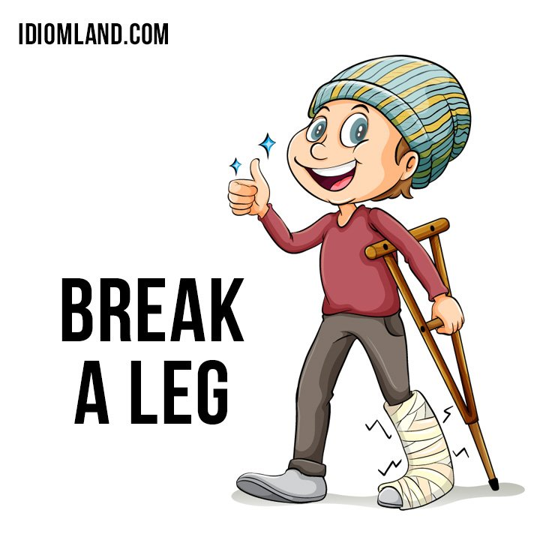
Idiom
phrases that have a completely different meaning. These are NOT to be taken literally!
that’s easy

Slide 15
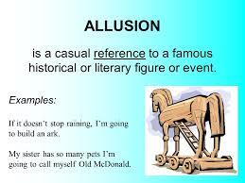
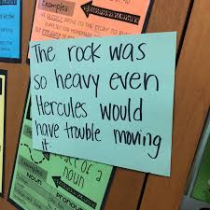
Allusion
phrases that refer to a historic person, place, event, or literature. Look for proper nouns.

Slide 16
Personification, simile, metaphor, idiom, allusion, hyperbole, alliteration, or onomatopoeia???
The street cars are like frosted cakes covered with snowflakes.
The west wind dances down the road.
A train is a dragon that roars through the dark.
The test was a piece of cake.
She’s as tiny as a mouse.
Her blonde hair shined like the sun.
7. Susan suddenly stretched slowly.

Slide 17
KEY: Personification, simile, metaphor, oxymoron, hyperbole, alliteration, or onomatopoeia???
The street cars are like frosted cakes covered with snowflakes.
The west wind dances down the road.
A train is a dragon that roars through the dark.
The test was a piece of cake!
She’s as tiny as a mouse.
Her blonde hair shined like the sun.
7. Susan suddenly stretched slowly.
simile
personification
metaphor
idiom
simile
simile
alliteration

Slide 18
Practice Test
The lightweight fighter lost so much weight,
he looked as thin as a rail.
Polly Peters positively played Ping-Pong.
When the pitcher finished nine innings, he was hungry enough to eat a horse.
“Crack” went the bat as the pitcher hit a home run.
The ice in the arena was as smooth as glass.
The kite drank the wind and laughed across the sky.
He was an Einstein in class today.
The trophy glistened like gold in the sun during the awards ceremony.
Happy Harry handles handsprings horribly.
10. The water was a glove that enveloped the swimmer’s body.

Slide 19
Practice Test KEY
The lightweight fighter lost so much weight,
he looked as thin as a rail.
Polly Peters positively played Ping-Pong.
When the pitcher finished nine innings, he was hungry enough to eat a horse.
“Crack” went the bat as the pitcher hit a home run.
The ice in the arena was as smooth as glass.
The kite drank the wind and laughed across the sky.
He was an Einstein in class today.
The trophy glistened like gold in the sun during the awards ceremony.
Happy Harry handles handsprings horribly.
10. The water was a glove that enveloped the swimmer’s body.
simile
alliteration
hyperbole
onomatopoeia
simile
personification
Allusion
simile
alliteration
metaphor

Slide 20
Figurative Language Quiz
The hockey player lost his control when the puck ran
across the ice.
The snow on the ski hill was powdered sugar.
The coach was as upset as a lion when his team lost the game.
Freddy French fired five fabulous free throws.
The snowmobile was a rocket in the newly fallen snow.
The running shoes danced as the runner neared the finish line.
“Bang!” went the gun as the race started.
My phone sank in the water quicker than the Titanic.
Spotlighting several special sports shows seems significant for TV.
After the marathon, the runner was thirsty enough to drink the ocean.
The golf ball walked gently into the ninth hole.
The team members remained as cool as cucumbers after the game.
EXTRA CREDIT: What do all the sentences have in common? (besides containing figurative language)

Slide 21
Quiz Key
The hockey player lost his control when the puck ran
across the ice.
The snow on the ski hill was powdered sugar.
The coach was as upset as a lion when his team lost the game.
Freddy French fired five fabulous free throws.
The snowmobile was a rocket in the newly fallen snow.
The running shoes danced as the runner neared the finish line.
“Bang!” went the gun as the race started.
My ohone sank in the water quicker than the Titanic.
Spotlighting several special sports shows seems significant for TV.
After the marathon, the runner was thirsty enough to drink the ocean.
The golf ball walked gently into the ninth hole.
The team members remained as cool as cucumbers after the game.
EXTRA CREDIT: What do all the sentences have in common? (besides containing figurative language)
personification
metaphor
simile
alliteration
metaphor
personification
onomatopoeia
Allusion
alliteration
hyperbole
personification
simile
sports

