Slide 1
Conflict

Slide 2
Essential Questions:
What is a conflict?
Conflict
A problem between two characters or forces in the story.
What are the two main types of conflict?
Internal
A conflict (problem) that a character has with him/herself.
External
A conflict (problem) a character has with another character or outside force.

Slide 3
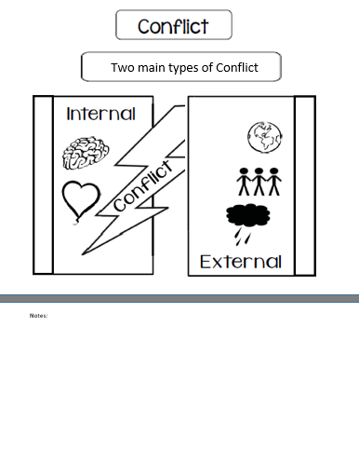
A conflict is a struggle between two characters or forces.
Internal Conflict is a struggle a character has with their own thoughts or emotions.
External Conflict is a struggle a character has with another character, society, or nature itself.

Slide 4
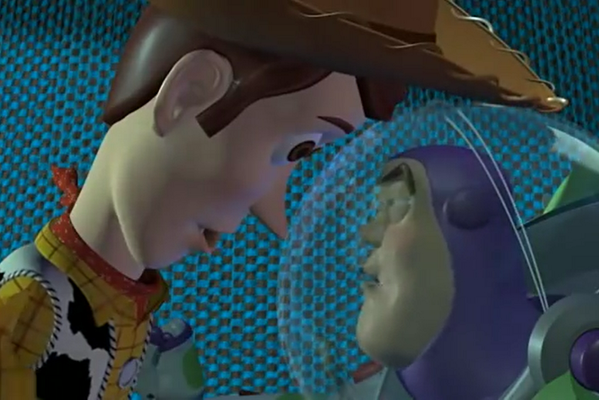
External Conflict
https://www.youtube.com/watch?v=9nuoxJyUdfQ

Slide 5
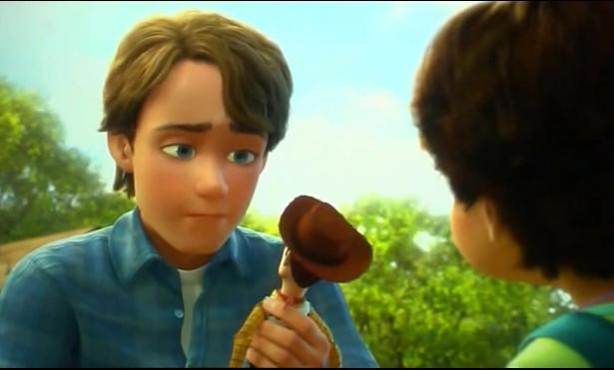
Internal Conflict
https://www.youtube.com/watch?v=AaTOiyNNE_Y

Slide 6
Essential Questions:
What is a conflict?
Conflict
A problem between two characters or forces in the story.
What are the four types of conflict?
Man vs. Self
A struggle the character has with feelings, conscience, or fears.
Man vs. Man
A mental or physical struggle between two characters.
Man vs. Nature
A struggle between a character and forces such as weather or animals.
Man vs. Society
A struggle between a character and the beliefs of society or a group such politics, religion, or poverty.

Slide 7
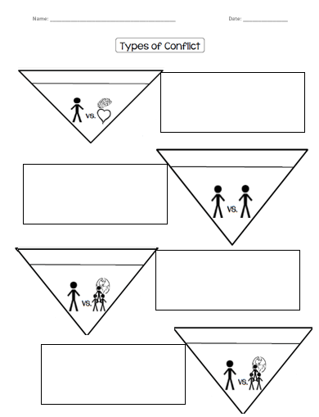
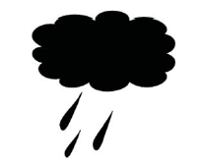
Man vs. Self
A struggle the character has with feelings, conscience, or fears.

Slide 8
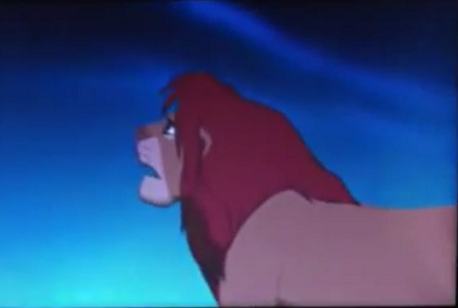
Conflict: Man vs. Self
https://www.youtube.com/watch?v=3JI2QlYZ3VM

Slide 9
Man vs. Self
A struggle the character has with feelings, conscience, or fears.
Man vs. Man
A mental or physical struggle between two characters.

Slide 10
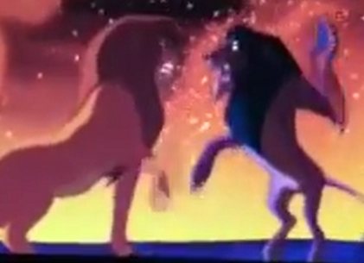
Conflict: Man vs. Man
https://www.youtube.com/watch?v=aDnaMpMzviw

Slide 11
Man vs. Self
A struggle the character has with feelings, conscience, or fears.
Man vs. Man
A mental or physical struggle between two characters.
Man vs. Nature
A struggle between a character and forces such as weather or animals.

Slide 12
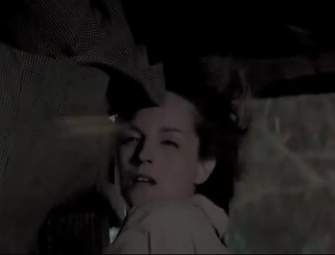
Conflict: Man vs. Nature
https://www.youtube.com/watch?v=N7LxzkB0imk

Slide 13
Man vs. Self
A struggle the character has with feelings, conscience, or fears.
Man vs. Man
A mental or physical struggle between two characters.
Man vs. Nature
A struggle between a character and forces such as weather or animals.
Man vs. Society
A struggle between a character and the fear of family or society beliefs.

Slide 14
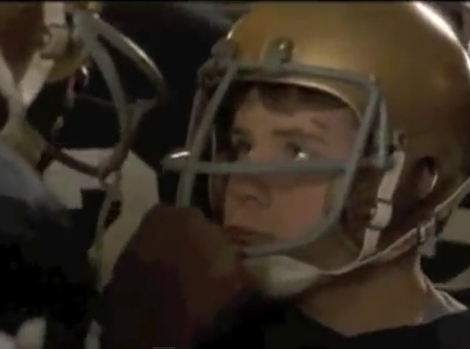
Conflict: Man vs. Society
https://www.youtube.com/watch?v=5RSO9paxHf8

Slide 15
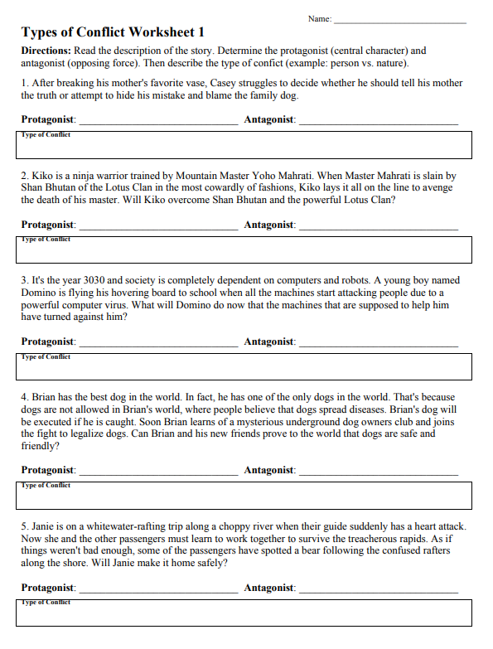

Slide 16
Essential Question Review:
What is a conflict?
Conflict
A problem between two characters or forces in the story.
What are the four types of conflict?
Man vs. Self
A struggle the character has with feelings, conscience, or fears.
Man vs. Man
A mental or physical struggle between two characters.
Man vs. Nature
A struggle between a character and forces such as weather or animals.
Man vs. Society
A struggle between a character and the beliefs of society or a group such politics, religion, or poverty.

